Slide 1
ASP.NET MVC CORE
Instructor: Edwin oduor

Slide 2

Quote of the day

Slide 3
Lesson objectives
Model
Db Context Class

Slide 4
Lesson pre-requisites
In order to take full advantage of this section you need to have the following;
Computer with Visual Studio Installed.
Stable Network Connection.

Slide 5
Training methods and extra readings
TRAINING METHODS FOR THIS LESSON
EXTRA READINGS
Lecturing Method – This is the main method of training to be adopted in this lesson with illustrations and practical coding examples.
Discussion Method - This method will be adopted periodically whereby learning will be derived principally from the students brainstorming together, rather than from the trainer. Three main types of discussions will be used:
Directed discussion
Developmental discussion
Problem-Solving discussion
Home and Learn C#

Slide 6
MODEL

Slide 7
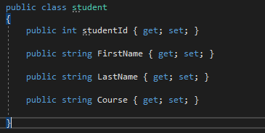
A model is a class that is responsible with the data logic. The model is the one that is going to interact with the database, to retrieve the data. that the controller requested for. In this session we will be learning in-depth about models, how to create models.
To create a model, in the solution explorer right click on the model’s folder Add >> Class, then give it a name. Once the name has been given the next thing is to add properties in the new class created.
In our case we are creating a class called student that is going to have the following fields.

Slide 8
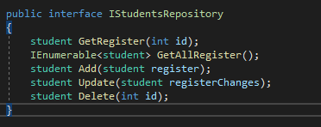
The next will create an Interface. That will have the various methods that we will use as we continue. Remember when creating an Interface as a good practice the name of the interface should start with an “I” this is to prevent the programmer from confusing it with a class. We have an interface by the name IStudentsRepository.
To create an Interface Right click on the Models folder >> Add >> New Item >> Interface >> give the interface a name then click Add.

Slide 9
After the interface is created, will create a class that will make it possible to connect to the database.
The class to be created, that will make it possible to connect to a database is DbContext class.
DbContext class – It’s used to interact with the database, it’s the one used to manage database connection, retrieve and save data in the database. This is a very important class that is found in the Entity Frame work.
To use the DbContext class we need to install Entity FrameworkCore in our project.
To install it right click on your project >> Manage nugget packages, A dialogue box will open then ensure you are on the browse tab, search for the name Entity FrameworkCore.SqlServer

Slide 10
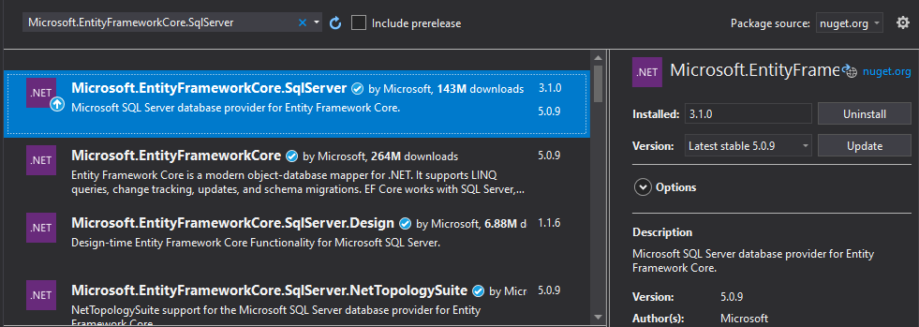
Image showing how to install Entity Framework Core. In my case I have Uninstall because I had already installed it, in your case it should show install because it’s not yet installed in your projects.

Slide 11
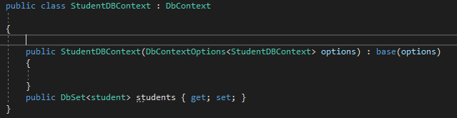
After Entity Framework has been installed, we need to create a class (DbContext) in the models Folder, right click on the folder >> Add >> Class give it a name in our case will give it StudentDbContext, the class created is going to inherit from the DbContext class, so that to make it behave like a DbContext class.
The easiest way to pass the instance of the created class is by creating a constructor.
The next thing is to add a DbSet property for our student class, will be using this to save and query instances of the student class.

Slide 12
We need to add a connection string to connect to the database. The code for the connection string is going to be added in the appsettings.json file.
Data Source = . This means that we are connecting to a local database.
Database – The name of the database.
Trusted_Connection/ Integrated Security – windows connections of the current user is what is being used to authenticate against SQL.
After all this is done the next thing that will do is to create a class that is going to implement the interface.

Slide 13
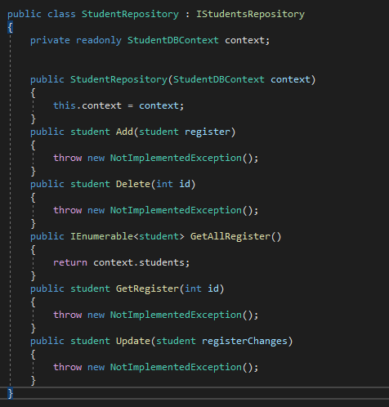
This is the class that is implementing the interface. Name of our class is StudentRepository.

Slide 14
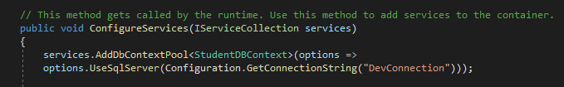
After all that is done next is to register our DbContext class in the startup.cs file. Inside the Configure Services class will write the following code. This code will make it possible to use the connection string that we saved in the startUp.cs file.
UseSqlServer will be underlined to solve this then one has to install Microsoft.EntityFrameworkCore.SqlServer 3.1.0 based on the package being used in your project.

Slide 15
Will go back to the student repository class so that we can implement the various crud operations.
First we need to pass in the StudentDBContext into our class and this is done through the use of a constructor.
Then will have a private readonly class that will use in the methods inside the class.
After all that is done the next will be to write code for the functions inside the class.

